Slide 1
Income Inequality, Food Access, and Obesity
Jennifer Dusendang

Slide 2
Research Questions
How do neighborhood preferences and rent prices lead to income segregation?
How do lack of transportation and cost of healthy food lead to differences in BMI among different income groups?

Slide 3
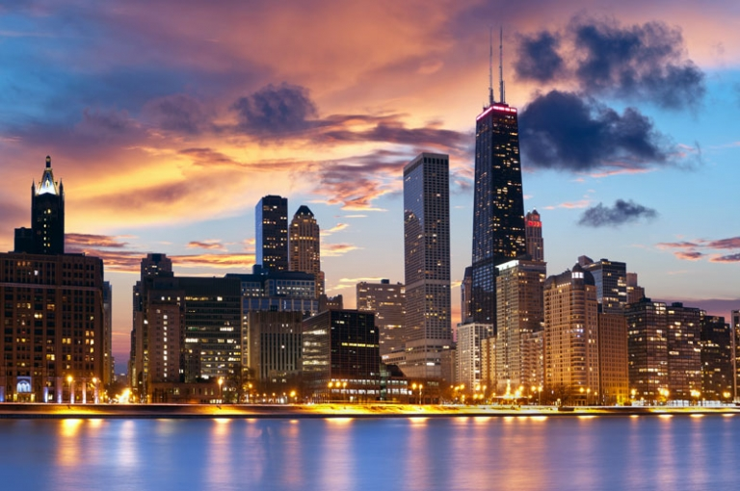
Space
103 x 103 grid space
No wrapping of edges
Large urban area approximately the population of Chicago, IL or Houston, TX

Slide 4
Agents
Units
10,000 units - each represents 250 people for total population of 2,500,000
Randomly assign income (low or high)
Randomly assign starting BMI along normal distribution from 1971 data: mean = 25.3; standard deviation = 3.745
Randomly assign starting grid space
Stores
1200 stores
Randomly assign food type (healthy or unhealthy)
Randomly assign starting grid space

Slide 5
Assumptions

Slide 6
Main Assumptions
People with lower income have less access to transportation making it more difficult for them to travel far for food
Healthy food is more expensive than unhealthy food
There are no other reasons why people would choose healthy or unhealthy food (marketing, knowledge, etc.)

Slide 7
Each Year

Slide 8
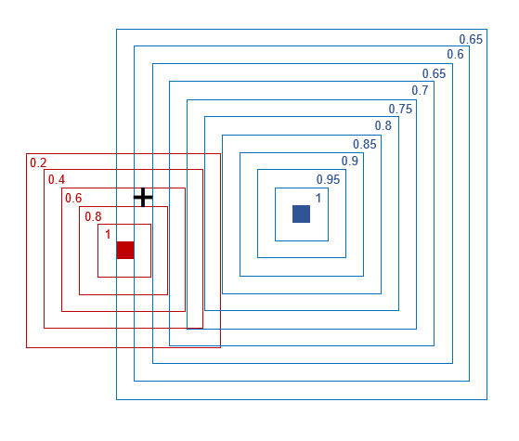
At Each of 20 Timesteps:
Units look for a place to shop
The distance between units and stores is calculated and given a weight – the higher the distance the lower the weight
This weight is also more severe for low income units than for high income units
Healthy stores are also given a weight of 0.5 for low income units based on unaffordability of food

Slide 9
At Each of 20 Timesteps:
Score = transport weight * cost weight
Units shop at the highest scoring store
If the scores are tied one of the high scoring stores is randomly selected
If selected store is a healthy store the unit BMI increases by 1 (~ 10 lbs)
If selected store is an unhealthy store the unit BMI decreases by 0.25

Slide 10
At Each of 20 Timesteps:
If less than 2 neighbors are of the same income status the unit will randomly move to a new grid space
If a store has too few shoppers the store will randomly move to a new grid space

Slide 11
Results

Slide 12
Key
Low Income Unit – Red Square
High Income Unit – Blue Square
Unhealthy Store – Green +
Healthy Store – Gray +
BMI – higher BMI is darker red or blue; lower BMI is lighter

Slide 13
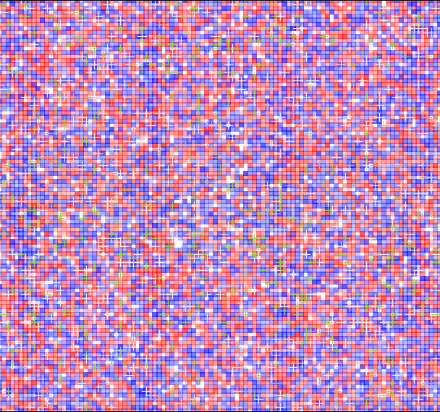
Baseline

Slide 14
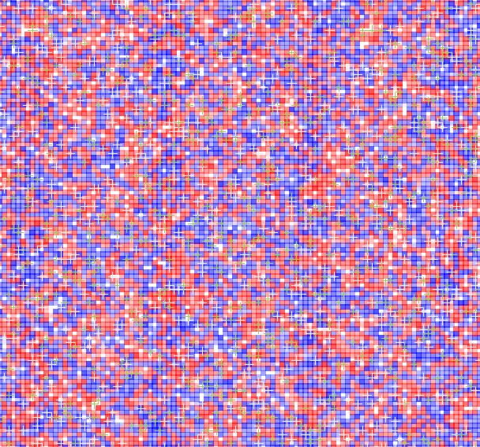
Year 1

Slide 15
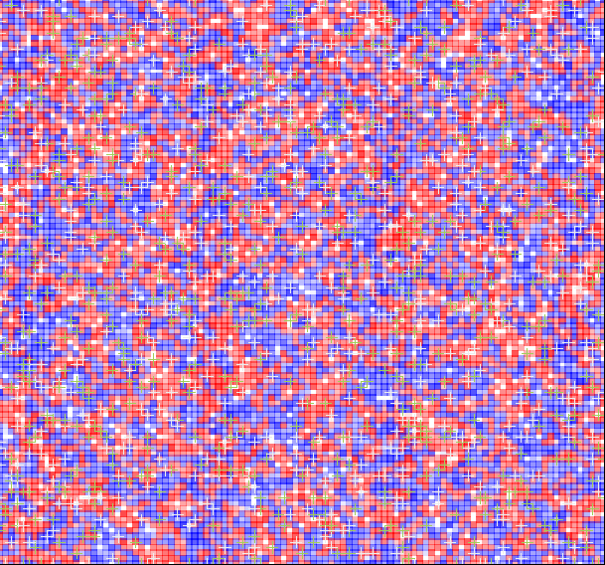
Year 2

Slide 16
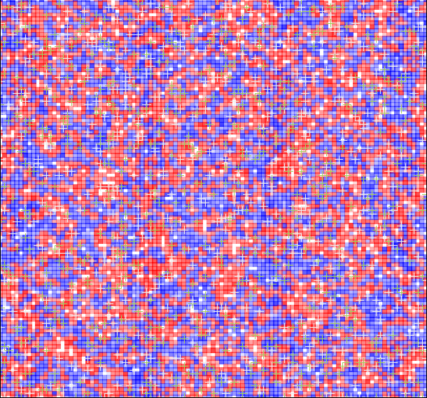
Year 3

Slide 17
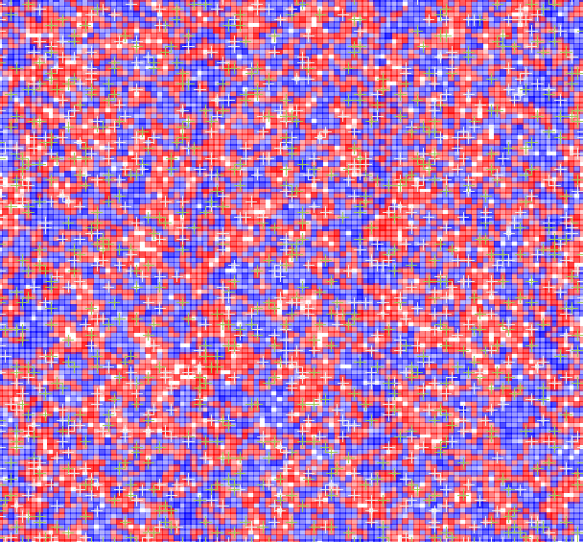
Year 4

Slide 18
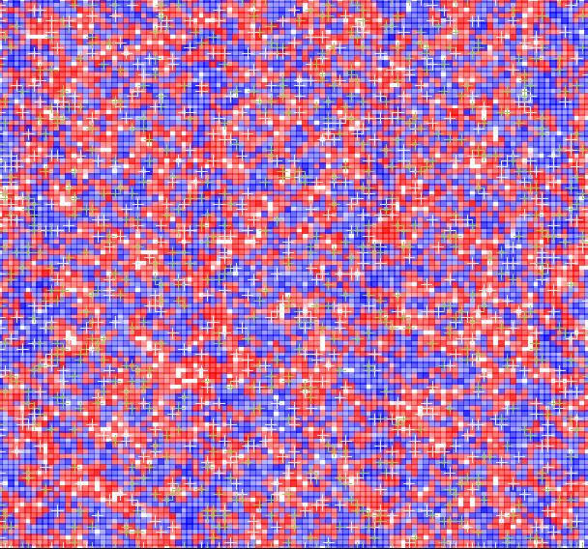
Year 5

Slide 19
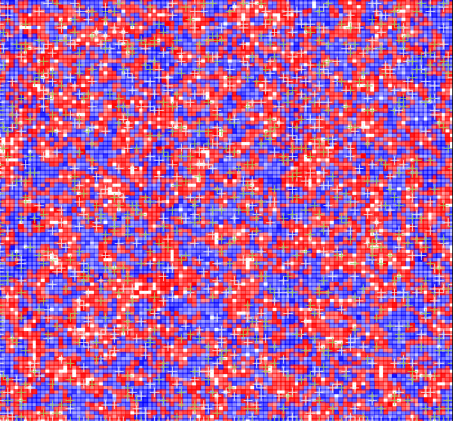
Year 10

Slide 20
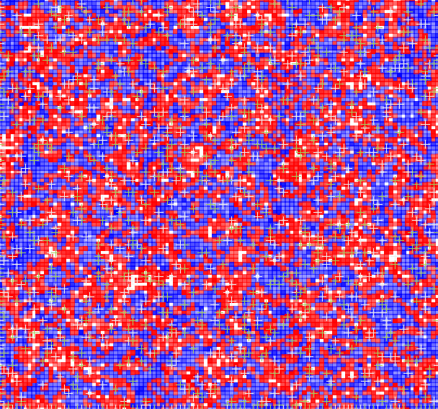
Year 15

Slide 21
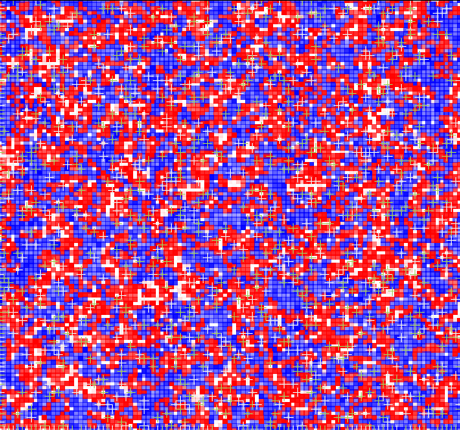
Year 20

Slide 22
Baseline & Year 20

Slide 23
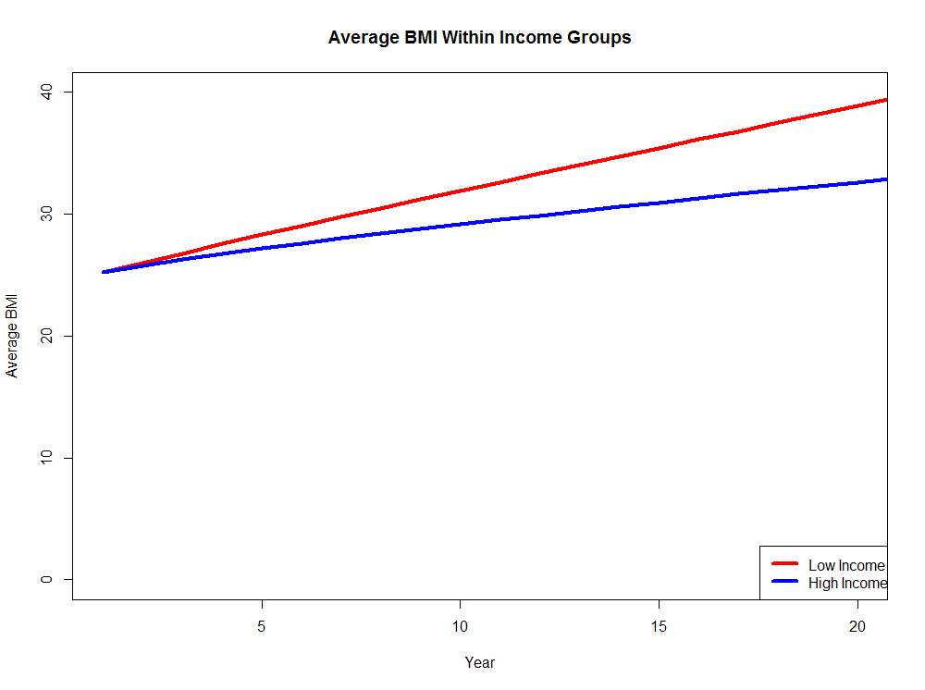
Final Results
BMI increased for everyone
BMI increased more for low income units than for high income units
Segregated neighborhoods developed quickly

Slide 24
Future Ideas
Include food preference – randomly assigned at beginning but changed based on targeted marketing, diet programs, vouchers, or markets
Create more realistic models by including randomly assigned levels of physical activity
Look at how neighborhood characteristics influence stores

Slide 25
Questions?

Slide 26
Sources
https://www.ncbi.nlm.nih.gov/pmc/articles/PMC3651246/
https://www.ncbi.nlm.nih.gov/pubmed/21335261
https://urbanland.uli.org/economy-markets-trends/rethinking-grocery-stores/

